Slide 1
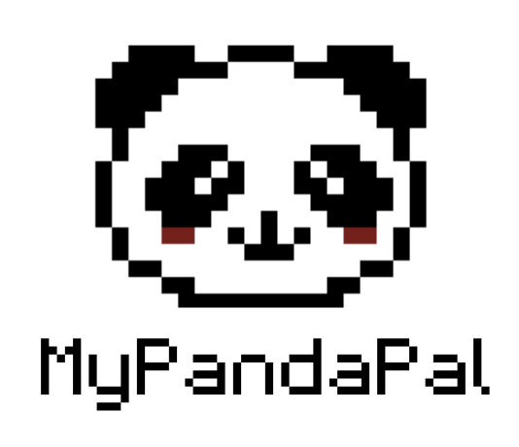
MyPandaPal
Gamified Habit Tracker
1 UP 25000
2 UP 003200
SOPHIE LUO, EDWIN OR, DYLAN STA ANA, ERIC ZHOU
©
BY SLIDESGO
CREDITS

Slide 2
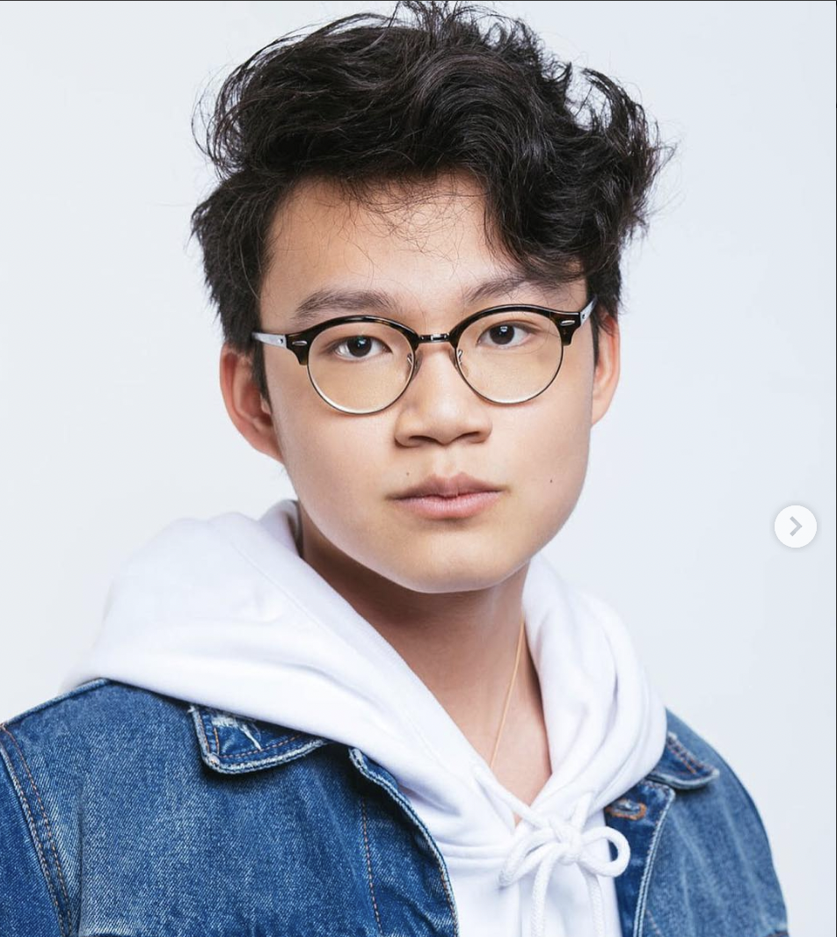
MEET ANTHONY
I’m a second-year university student studying Computer Science and Business.
Pain Points
I have an extremely busy schedule, leading to burnout.
I’ve been wanting to practice healthier habits but not sure where to start.

Slide 3
STUDENT BURNOUT IN 2023
51%
of university students report feeling burnt out on a daily basis.
Many students forget to schedule time to eat proper meals and practice healthy habits.

Slide 4
SOLUTION

Slide 5

SOLUTION
+
=
GAMIFICATION
HABIT REGULATION
HABIT
TRACKING
E.g eating, drinking, sleeping, exercising
Challenge to take care of pet

Slide 6
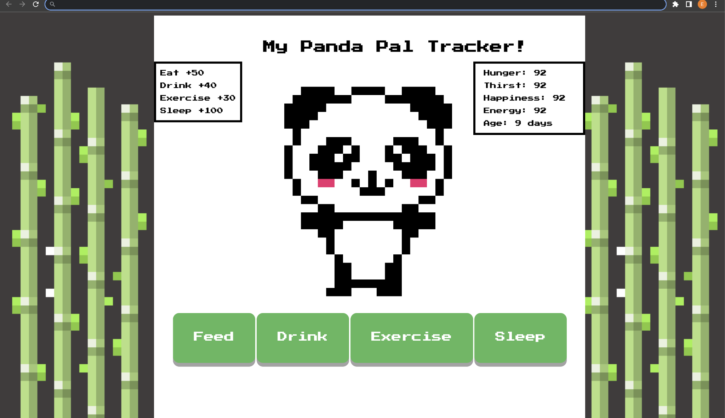
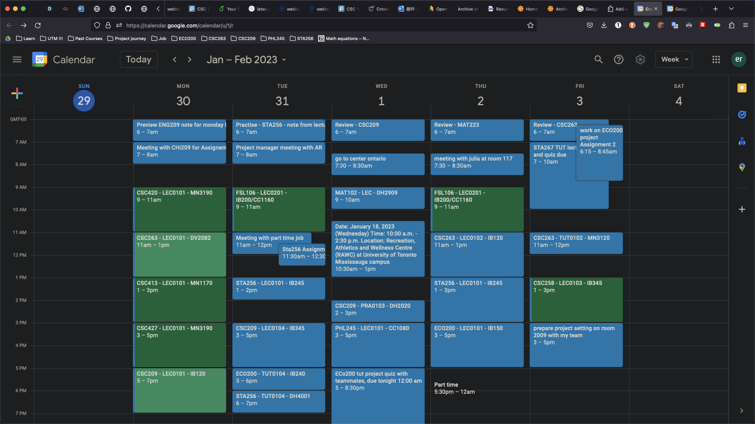
SOLUTION

Slide 7
MyPandaPal OVERVIEW
Key Features
Chrome Extension
Built-in real-time notifications
Personalized progress tracking

Slide 8
WHAT DOES THIS LOOK LIKE?
Personal Stats
Points Legend
Interactive Panda Pet
Habit Tracker Buttons

Slide 9

MyPandaPal DEMO!

Slide 10
MyPandaPal IMPACT
Key Impacts
Motivation to take care of panda (i.e. yourself)
Reduced burnout
Healthier daily habits

Slide 11
Thank you.

